Slide 1
Methods/Functions

Slide 2
Methods/Functions
A method/function is a block of code which only runs when it is called.
You can pass data, known as parameters, into a function.
Methods are used to perform certain actions, and they are also known as functions.

Slide 3
Why use methods or functions?
To reuse code: define the code once, and use it many times.

Slide 4
Java Methods
A method must be declared within a class.
It is defined with the name of the method, followed by parentheses ().
Java provides some pre-defined methods.

Slide 5
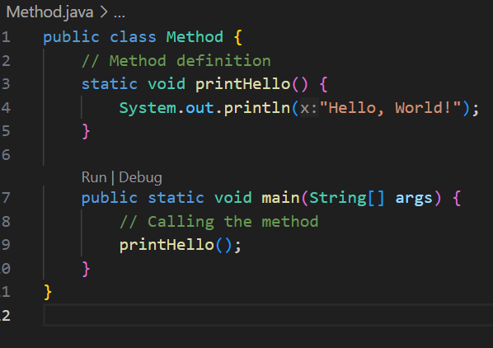

Slide 6
printHello() is the name of the method
static means that the method belongs to the Main class and not an object of the Main class. You will learn more about objects and how to access methods through objects later in this tutorial.
void means that this method does not have a return value. You will learn more about return values later in this chapter

Slide 7
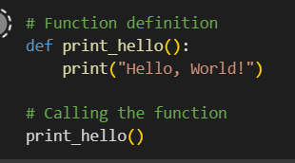
Python Function

Slide 8
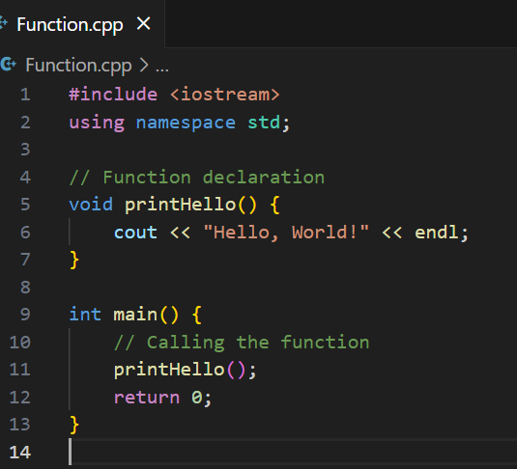
C++ Function

Slide 9
printHello() is the name of the function
void means that the function does not have a return value. You will learn more about return values later in the next chapter
inside the function (the body), add code that defines what the function should do

Slide 10
Parameters and Arguments
Information can be passed to methods as parameter. Parameters act as variables inside the method.
Parameters are specified after the method name, inside the parentheses.
You can add as many parameters as you want, just separate them with a comma.

Slide 11
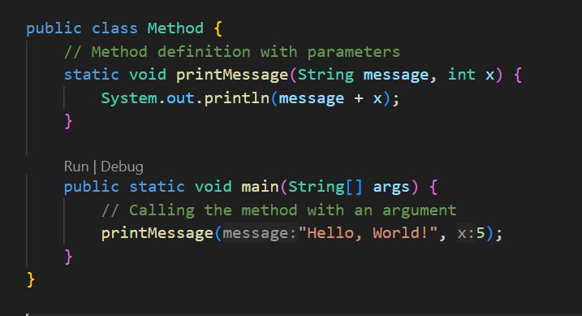
Java

Slide 12
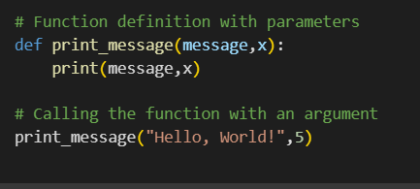
Python

Slide 13
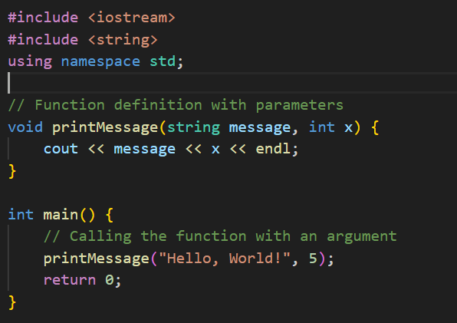
C++

Slide 14
Task….
Create a method/function named calculateRectangleArea that takes two parameters, length and width.
Create a method/function named printGreeting that takes a parameter name. Print a personalized greeting message, such as "Hello, [name]!".
Create a method/function named findMax that takes three parameters, num1, num2, and num3.
Create a method/function named concatenateStrings that takes two parameters, str1 and str2.

